Slide 1
GPGPU PROCESSING IN CUDA ARCHITECTURE
Presenter: Kang Hong Bo

Slide 2
Table of Contents
Introduction and background
Problem statement and hypothesis
Related work discussion
Methodology
Proof of concept
Analysis of results
Reference

Slide 3
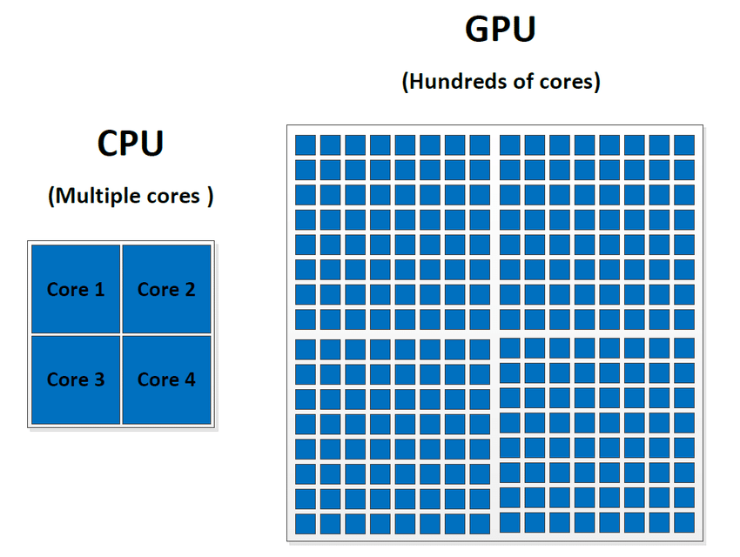
Introduction and background
Central processing unit (CPU)
- single-chip processor
- used to handle all of the computation
Graphical processing unit (GPU)
- Runs high definitions graphics
- Compute 3D functions
- More core compared to CPU
(Reference: Ghorpade, J., Parande, J., Kulkarni, M., & Bawaskar, A. 2012)

Slide 4
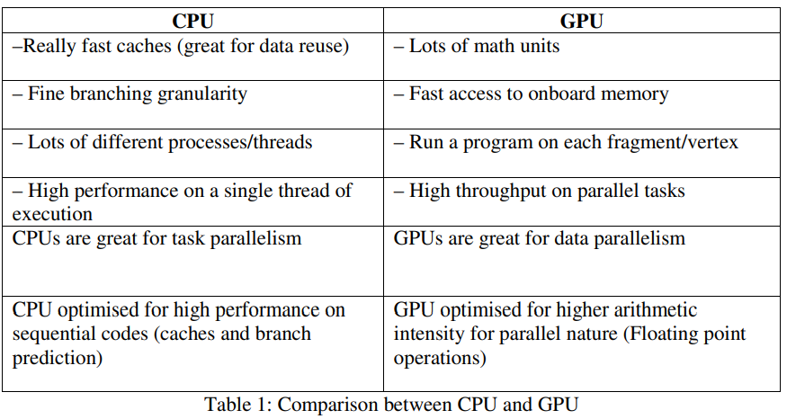
Introduction and background
(Reference: Ghorpade, J., Parande, J., Kulkarni, M., & Bawaskar, A. 2012)

Slide 5
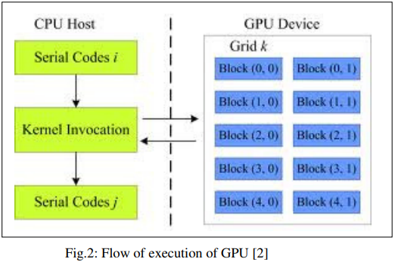
Introduction and background
General Purpose GPU
- Computation for intensive tasks
- Performing complex mathematical operations in parallel
Compute Unified Device Architecture (CUDA)
- NVIDIA’s GPU architecture was released in 2007
- provides 128 cooperating cores.
- advantage in massive computational power
(Reference: Ghorpade, J., Parande, J., Kulkarni, M., & Bawaskar, A. 2012)

Slide 6
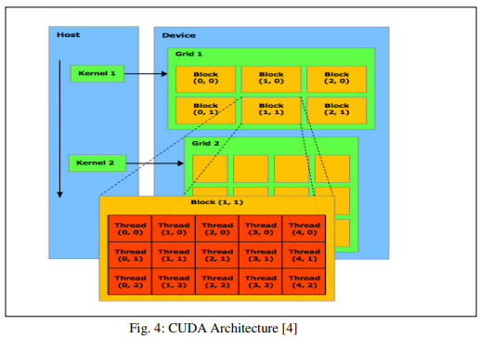
Introduction and background
(Reference: Ghorpade, J., Parande, J., Kulkarni, M., & Bawaskar, A. 2012)

Slide 7

Problem statement and hypothesis
GPGPU vs CPU
Will the time taken for a computer to calculate a complex mathematical problem be faster by using a GPU?
How much faster will it be?
Hypothesis: GPU should be faster compared to CPU
(Reference: Ghorpade, J., Parande, J., Kulkarni, M., & Bawaskar, A. 2012)

Slide 8
Related work discussion
Accelerate numerical electromagnetic method - explain how to exploit GPU features by examining how the computational time of the Finite-Difference Time Domain (FDTD) Method can be reduced
Parallel programming on GPUs using CUDA - dividing loops into threads, grids, and blocks results in effective implementation
Solve large-size optimisation problems using GPUs - examine the shortcomings existing in the current optimization problem-solving methods including limited time budget among other factors.
(Reference: Ghorpade, J., Parande, J., Kulkarni, M., & Bawaskar, A. 2012)

Slide 9
Methodology (Parallel computing with CUDA)
Molecular Dynamics
A simulation technique widely used in physics, chemistry, biology, and related fields. Its goal is to compute the movement of a number of atoms.
Numerical Linear Algebra
Matrix multiplication/factorizations
Medical Imaging
inverse-scattering algorithms to generate 3D volumetric images of the breast with ultrasound
Fluid Dynamics
blocking strategy similar to those used in matrix multiplication and image processing algorithms
Seismic Imaging
large amount of parallel computation involved in the seismic imaging process
(Reference: Garland, et al. , 2008)

Slide 10
Proof of Concept

Slide 11
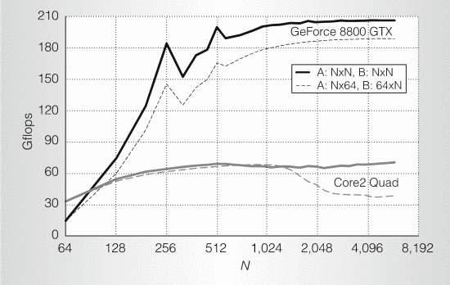
Analysis of results and Conclusion
GPU has a higher performance on mathematical problems.
N=1000 | Time
Serial (CPU) | 6.155015
Parallel (CPU) | 0.606188
CUDA (GPU) | 0.21539
Performance on dense matrix-matrix multiplication (SGEMM).
(Reference: Garland, et al. , 2008)

Slide 12
Thank You

Slide 13
Reference
1) Ghorpade, J., Parande, J., Kulkarni, M., & Bawaskar, A. (2012). GPGPU processing in CUDA architecture. arXiv preprint arXiv:1202.4347.
2) Garland, M., Le Grand, S., Nickolls, J., Anderson, J., Hardwick, J., Morton, S., ... & Volkov, V. (2008). Parallel computing experiences with CUDA. IEEE micro, 28(4), 13-27.

